Slide 1
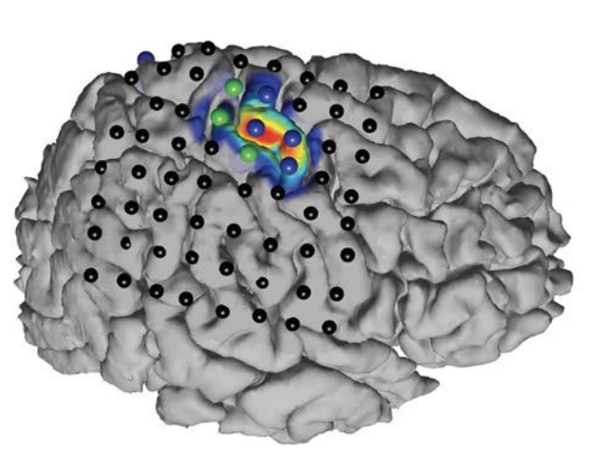
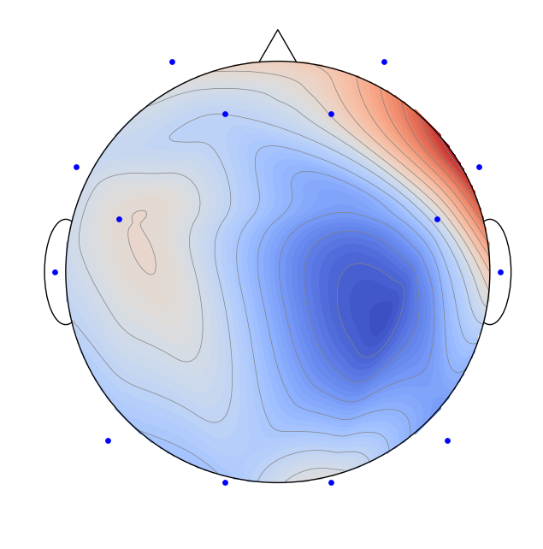
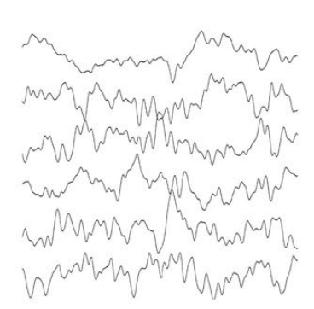

Spatial Filtering for Source Separation in EEG Data
Christian Endl, Felix Wirth, Korbinian Kunst & Taulant Koka

Slide 2
Agenda
Understanding the basis of Source Separation via an intuitive example-driven approach
Discussion of experiment design
Graph Blind Source Separation
Graph Blind Source Separation results
Summary of major outcomes
Problems and future research

Slide 3
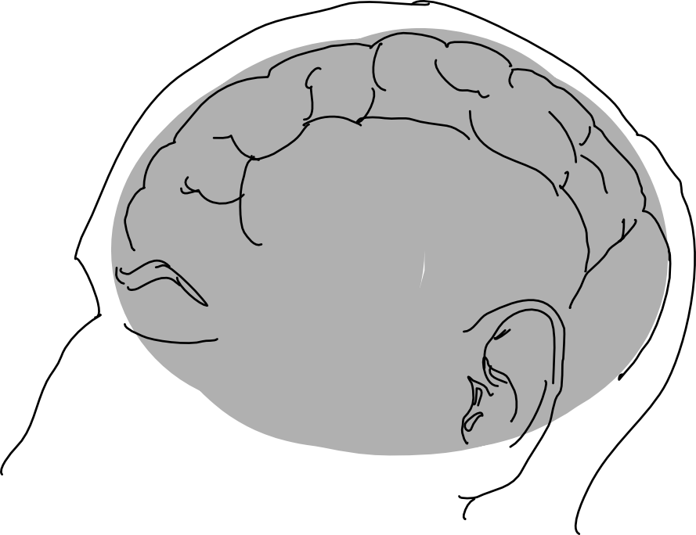
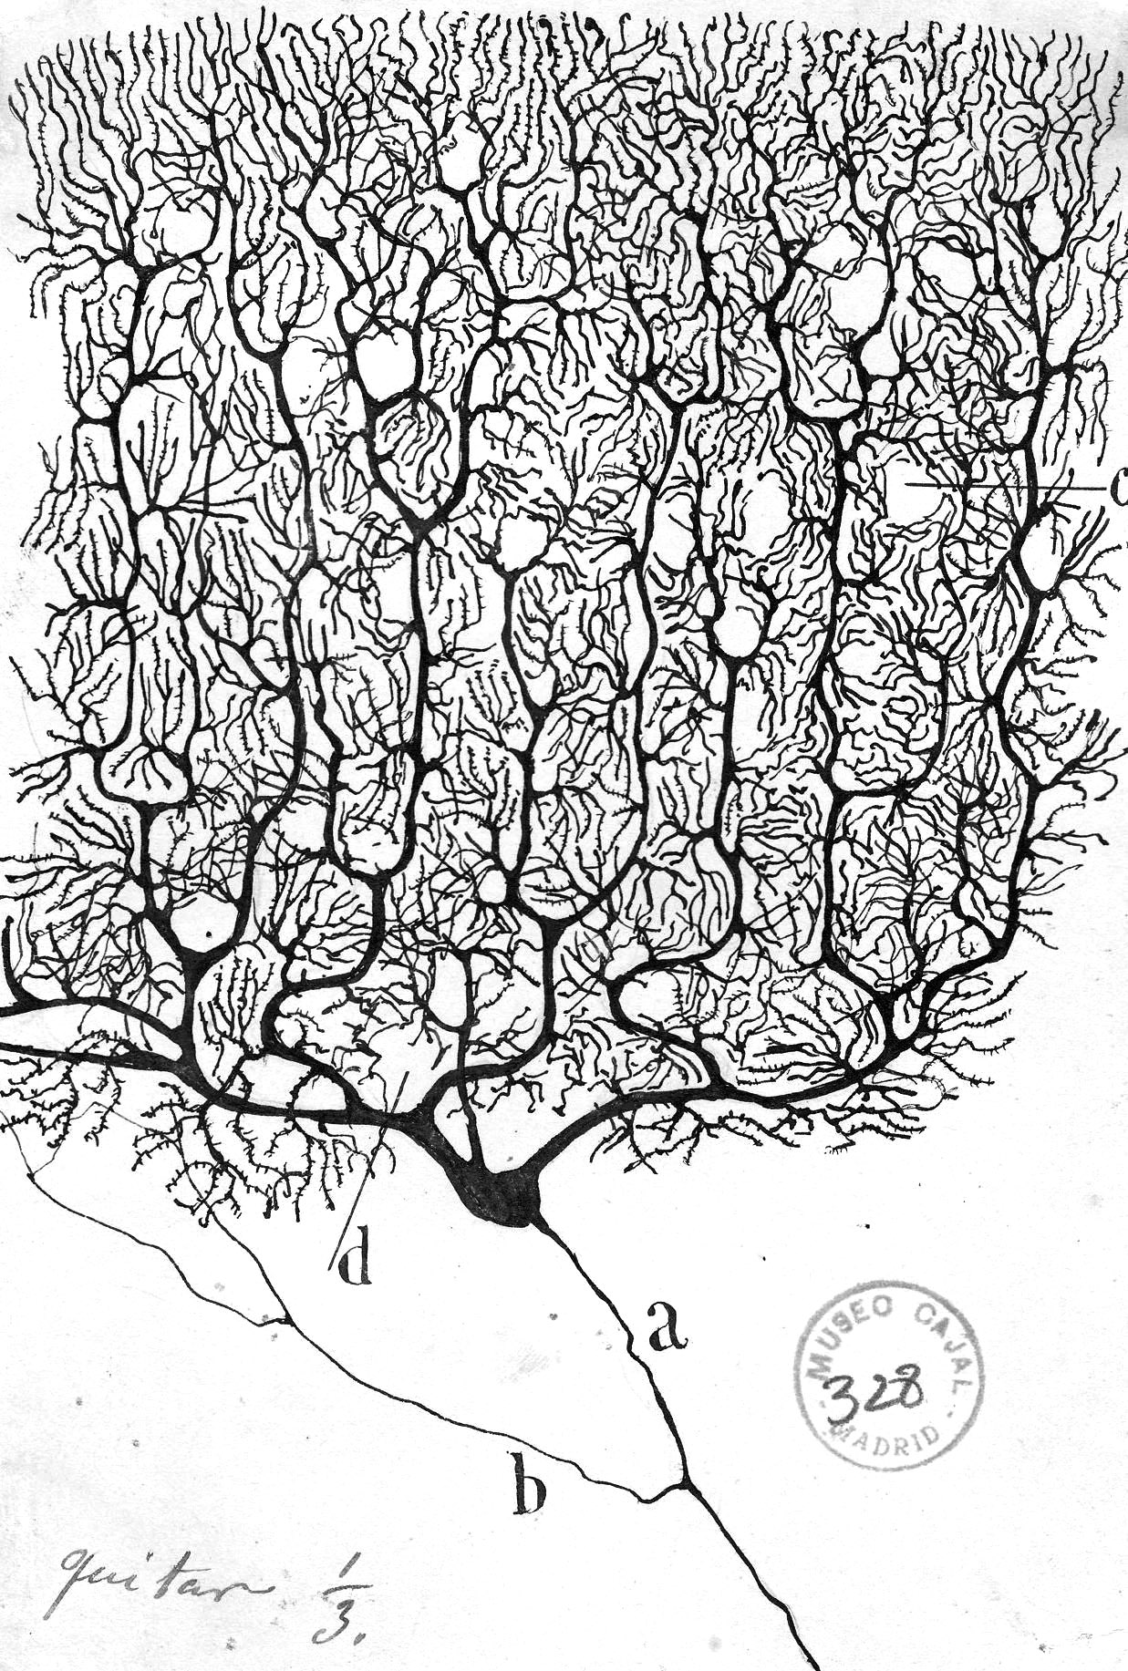
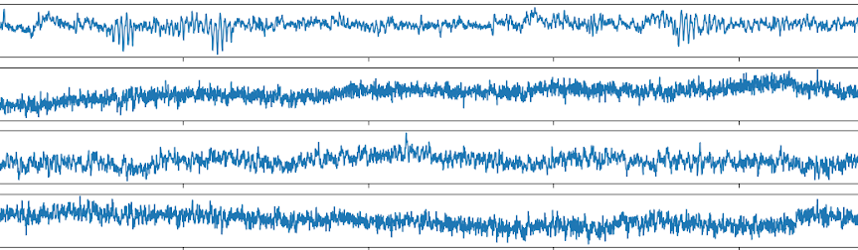
Motivation Challenge of Working with EEG Data
Electroencephalogram (EEG) Concept
What we wish to have?
[BackyardBrains]
We are observing the "oscillating slow fields" of neurons in the upper layers of the cerebral cortex.
These changes in electrical potential lead a neuron to be more likely or less likely to fire action potentials and are important in encoding information in the brain.
What do we get in experiments?
[NY Times, 2020]
“
Working with EEG data is
therefore the process of source separation
EEG Channels
time t in seconds
Notes:
The feature extraction of ICA was motivated by neurosciences that suggest that the similar principle of redundancy reduction explains some aspects of the early processing of sensory data by the brain.

Slide 4

Spatial Filtering for Source Separation Cocktail Party Problem
Def. I: In contrast to temporal filtering in DSP where a signal is analyzed as time-(in)variant subsequent discrete values of one channel, spatial filtering looks at the relation of a given timepoint across multiple channels.
Def. II: The topic of separating mixed sources is called Blind Source Separation (BSS) and can be solved by algorithms called Independent Component Analysis (ICA).
iStock
Notes:
Sosund is particular good example because sound add linearly

Slide 5


The Concept of Source Separation Cocktail Party Problem

Slide 6
The Concept of Source Separation Cocktail Party Problem

Slide 7


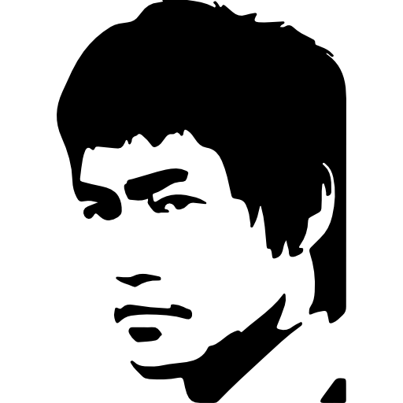

The Concept of Source Separation Cocktail Party Problem

Slide 8
The Concept of Source Separation Cocktail Party Problem
Original Signals (Sources)
Sensors
Reconstructed Signals
Latent Variables
Observed Data
Result of the ICA

Slide 9

The Concept of Source Separation Cocktail Party Problem
Original Signals (Sources)
Overlay of Signals
Sensors
Latent Variables
Mixing Matrix
Observed Data
$$s W x$$

Slide 10
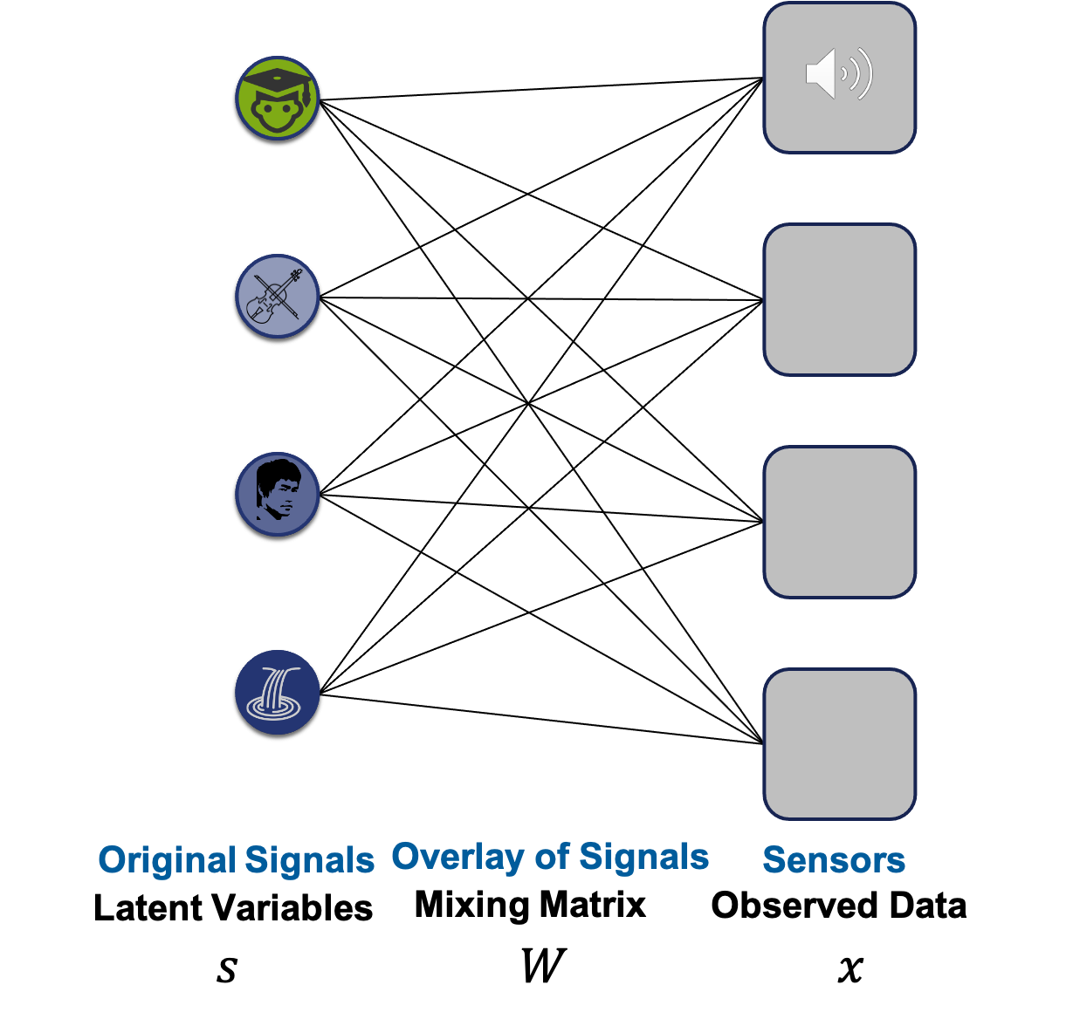

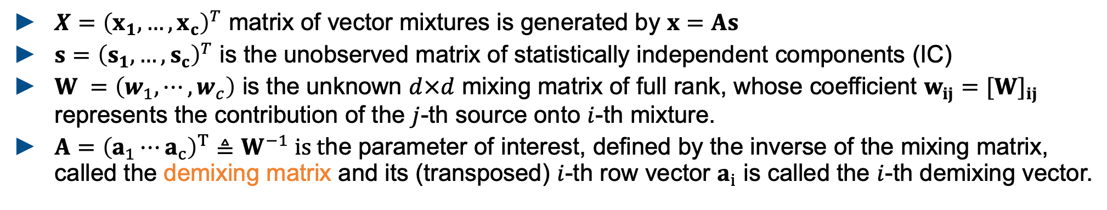

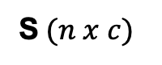

The Concept of Source Separation Math Formulation for ICA (Independent Component Analysis)
S$W=X$
S$(n x c)$
W$(c x c)$
X$(n x c)$
$X={\left(x_{1},…,x_{c}\right)}^{T}$ matrix of vector mixtures is generated by $x=As$
$s={\left(s_{1},…,s_{c}\right)}^{T}$ is the unobserved matrix of statistically independent components (IC)
$W =\left(w_{1},⋯,w_{c}\right)$ is the unknown $d×d$ mixing matrix of full rank, whose coefficient $w_{ij}=[W]_{ij}$ represents the contribution of the $j$-th source onto $i$-th mixture.
$A={\left(a_{1}⋯a_{c}\right)}^{T}≜W^{−1} is t$he parameter of interest, defined by the inverse of the mixing matrix, called the demixing matrix and its (transposed) $i$-th row vector $a_{i}$ is called the $i$-th demixing vector.

Slide 11
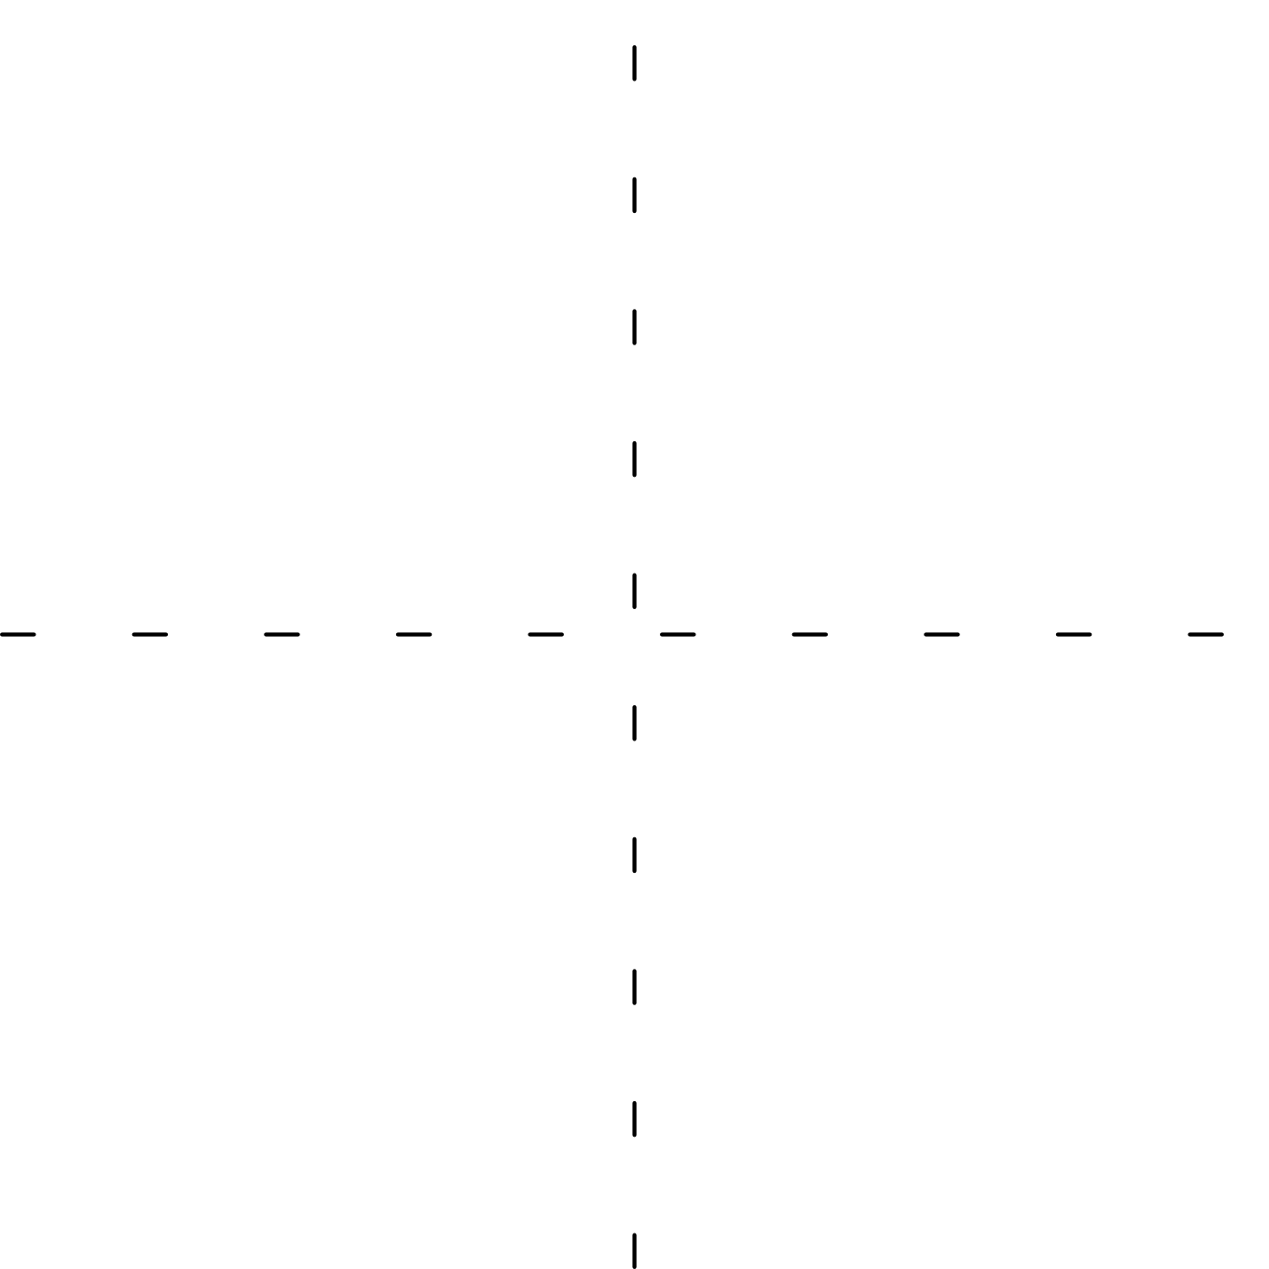

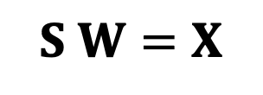
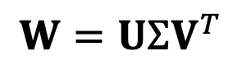

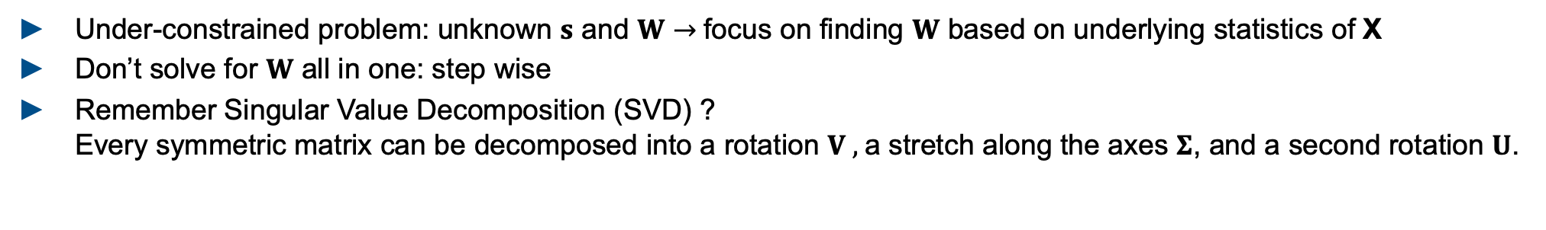

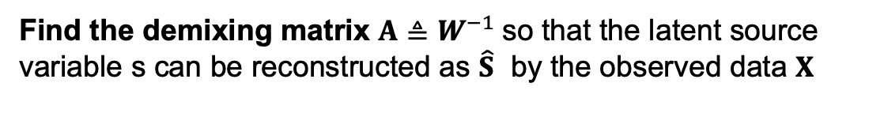


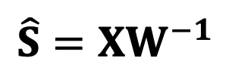


Independent Component Analysis Solving blind source seperation using ICA
What is the goal of the algorithm?
$$S W=X$$
$$\hat{S}=XW^{−1}$$
Find the demixing matrix $A≜W^{−1}$so that the latent source variable s can be reconstructed as $\hat{S}$ by the observed data $X$
How can we find W based on X?
Under-constrained problem: unknown $s$ and $W$ $→$focus on finding $W$ based on underlying statistics of X
Don’t solve for $W$ all in one: step wise
Remember Singular Value Decomposition (SVD) ? Every symmetric matrix can be decomposed into a rotation $V ,$a stretch along the axes $Σ$, and a second rotation $U$.
$$W=UΣV^{T}$$
$A$ $=VΣ^{−1}U^{T}$
$$V^{T}$$
$$Σ$$
$$U$$
$$V$$
$$Σ^{−1}$$
$$U^{T}$$
Notes:
The goal if ICA is to solve BSS problems which arise from a linear mixture
Find two unknowns A and s by only obersving theier matrix product x, underconstrained problem,
Amplitudes
Unsupervised learning problem

Slide 12
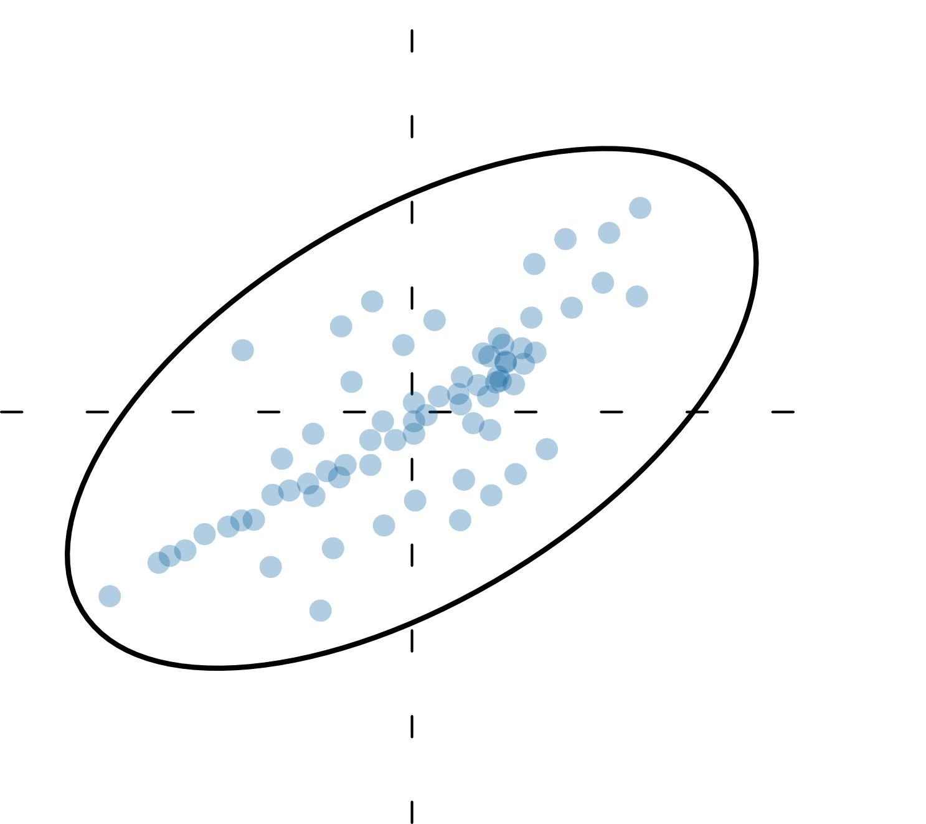
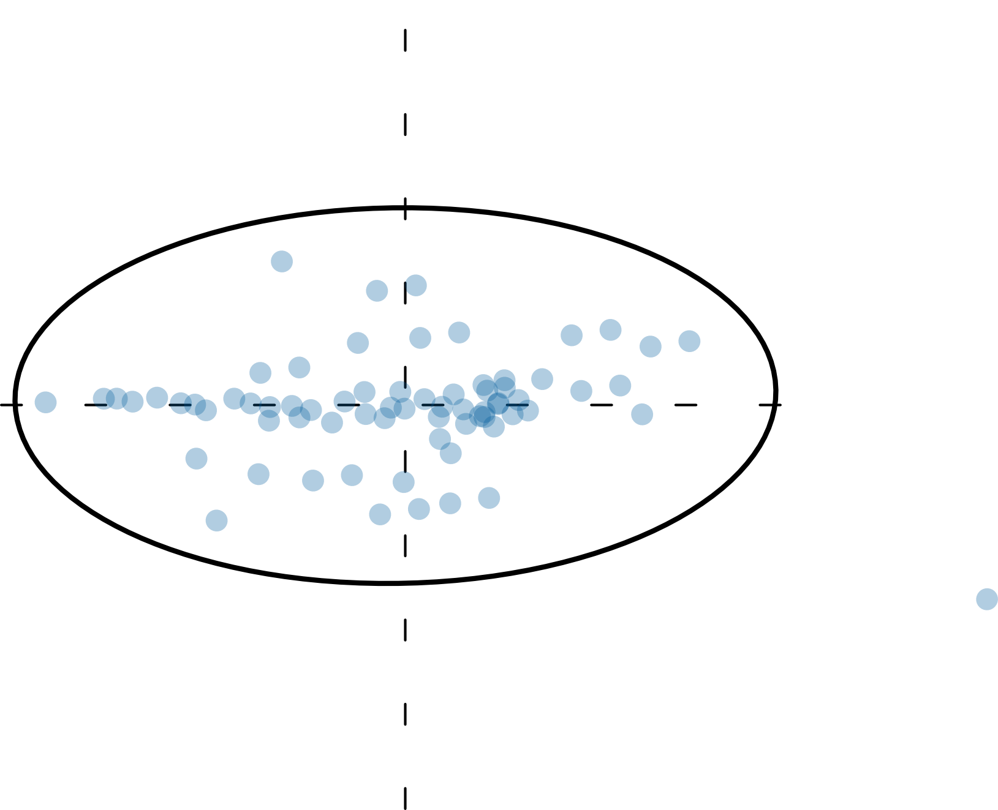
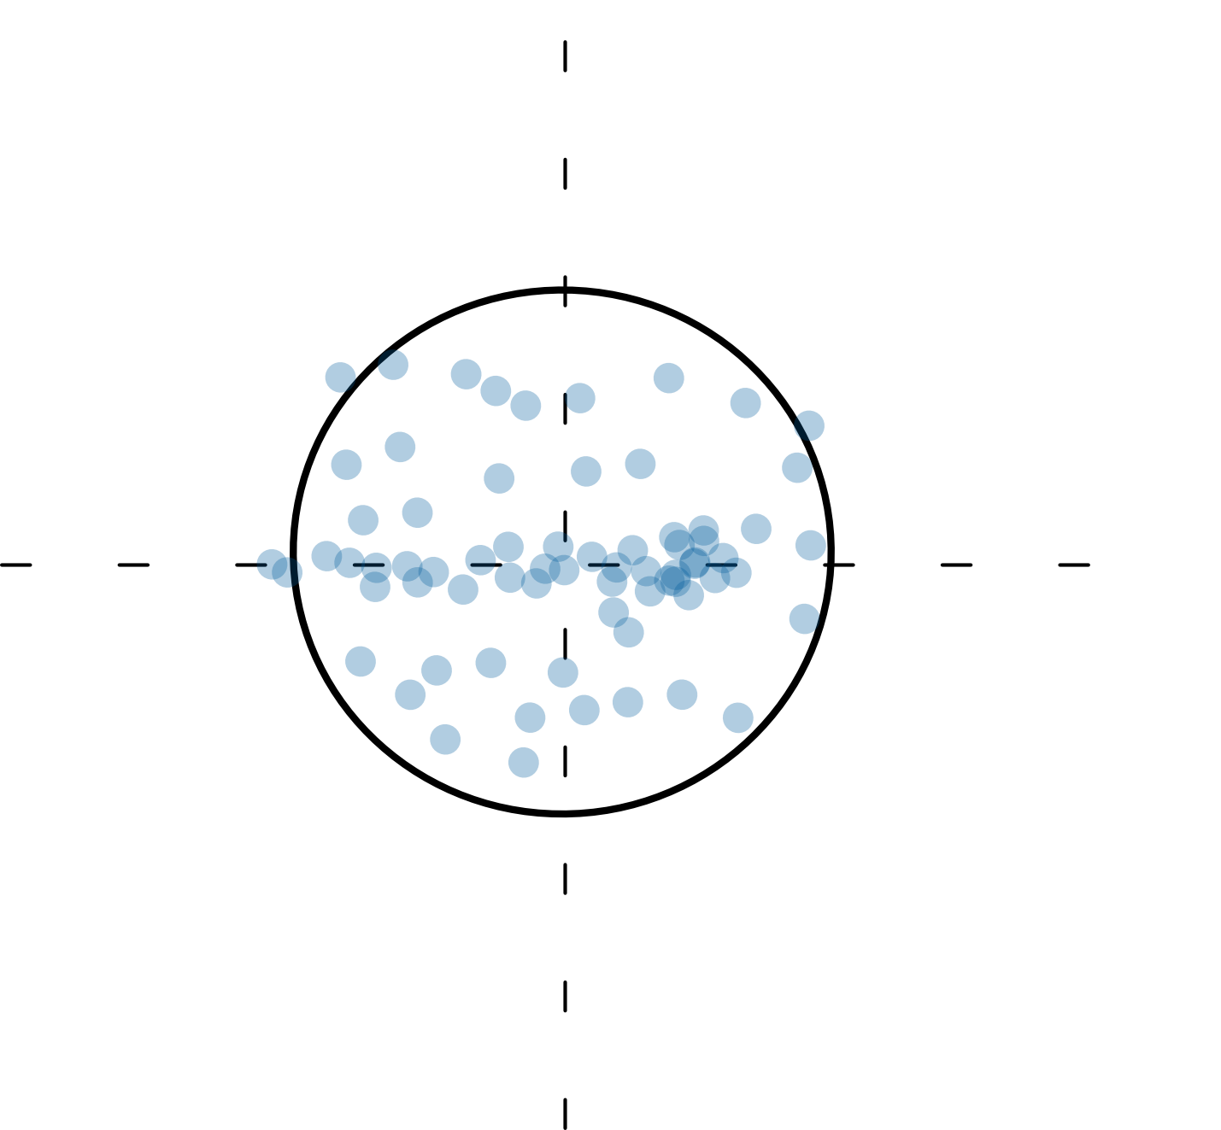
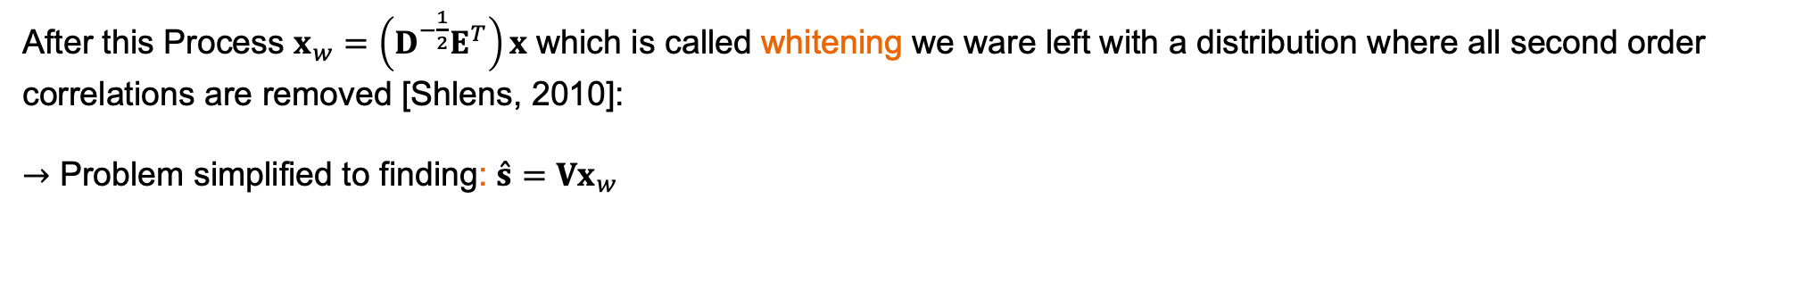


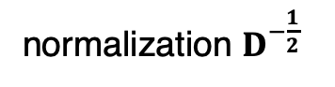

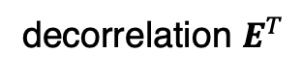

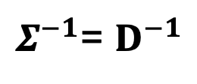
Independent Component Analysis Solving blind source seperation using ICA
If we can find each of the SVD components we can determine the unmixing matrix A
$A$ $=VΣ^{−1}U^{T}$
It can be shown that this can be formulated as an eigenvector problem, where:
$Σ^{−1}$= $D^{−1}$
$$\&$$
$$U^{T}=E^{T}$$
D, E are the singular values and eigenvectors computed from the covariance matrix of X ($Cov= E\left\{XX^{T}\right\}$)
decorrelation $E^{T}$
normalization $D^{−\frac{1}{2}}$
After this Process $x_{w}=\left(D^{−\frac{1}{2}}E^{T}\right)x$ which is called whitening we ware left with a distribution where all second order correlations are removed [Shlens, 2010]:
$→$ Problem simplified to finding: $\overset{ˆ}{s}=Vx_{w}$
need to exploit the statistics of independence to identify V
Notes:
The goal if ICA is to solve BSS problems which arise from a linear mixture
Projection the data onto the principal components aka aligning with cartesian coordinates removes linear correlation
Normalizes variance in each direction by multiplying with d^-0.5 => all dimensions are expressed in standard units
V measure of dipendency

Slide 13
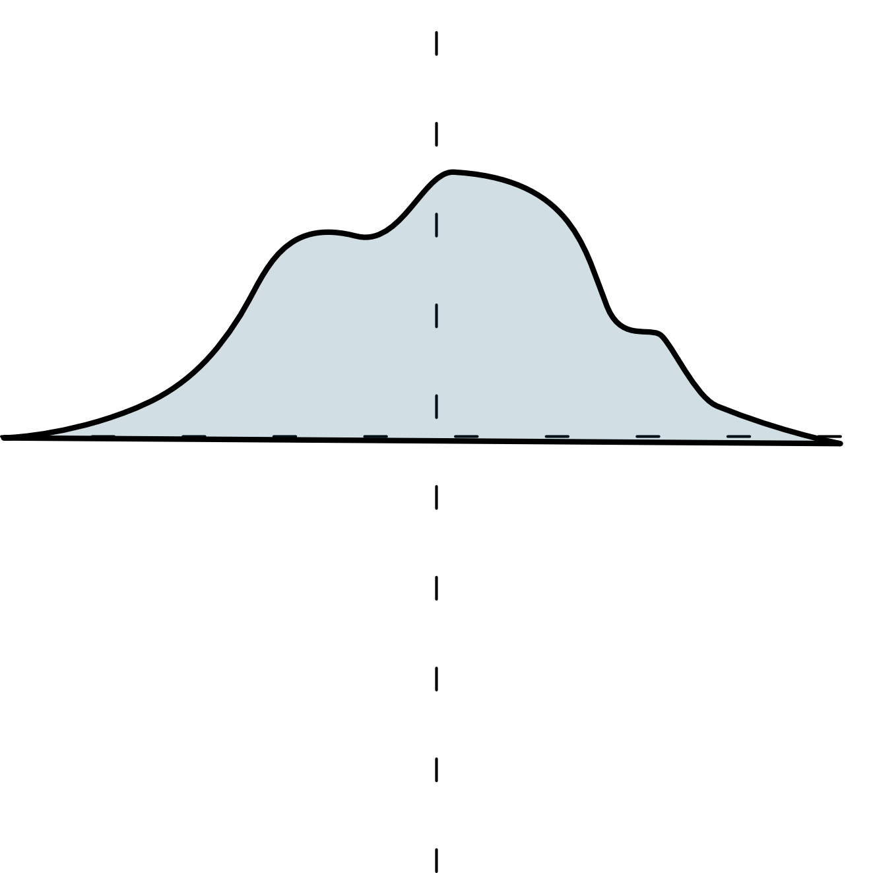
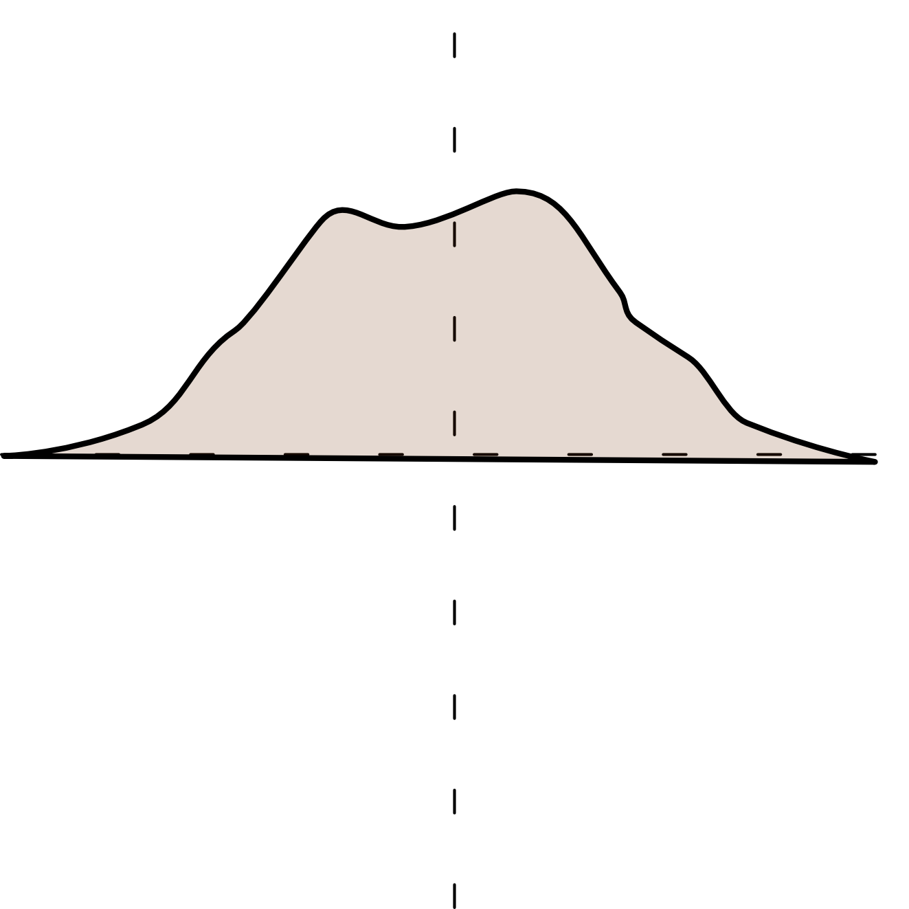
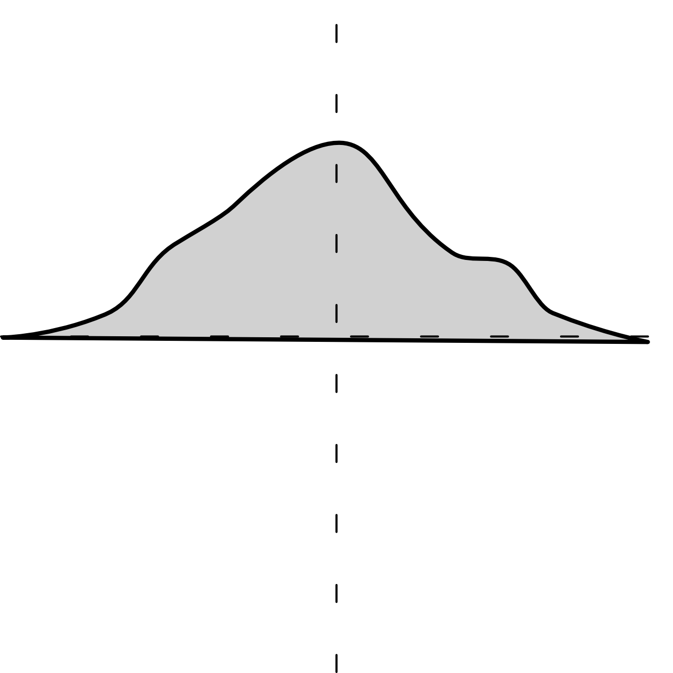
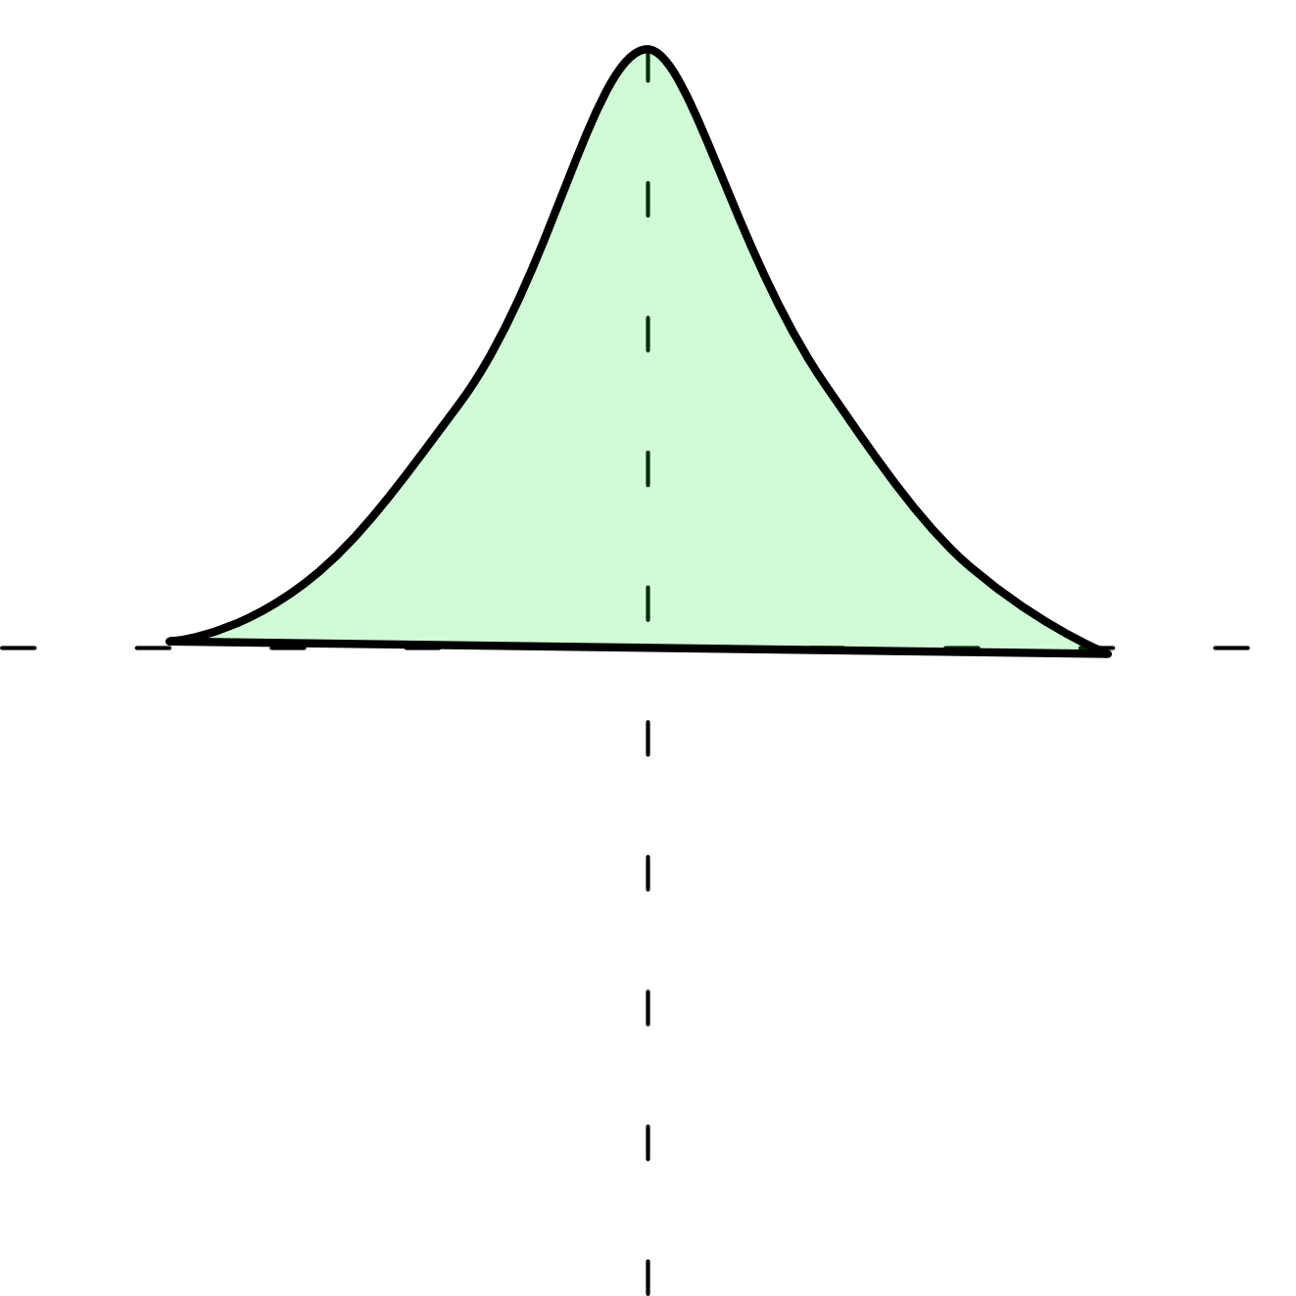

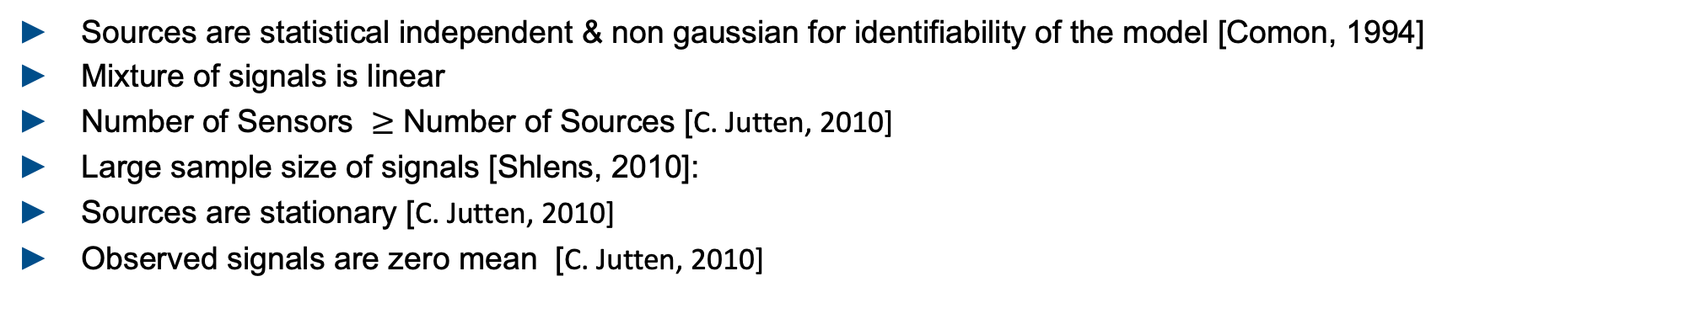

Notes On ICA Assumptions
How to measure statistical independence?
For ICA There are two main approaches [Haykin, 2009] [Hyvarinen, 2000]: a) rooted minimization of mutual information b) maximization of non-Gaussianity
Why is it possible?
$$+$$
$$+$$
Central limit theorem: two non gaussian distributions overlayed will be more gaussian than one
Meaning: multiple non gaussian distributions tend to form a gaussian distributions
We can use this: a gaussian distribution can also be decorrelated two non-gaussian distribution again
How can we measure non-gaussianity ?
Kurtosis, Entropy and measures derived from this [Hyvarinen, 2000]:
What are general assumptions for ICA?
Sources are statistical independent & non gaussian for identifiability of the model [Comon, 1994]
Mixture of signals is linear
Number of Sensors $≥$ Number of Sources [C. Jutten, 2010]
Large sample size of signals [Shlens, 2010]:
Sources are stationary [C. Jutten, 2010]
Observed signals are zero mean [C. Jutten, 2010]
Notes:
Can also be shown on mutial information (paper verweis, gaussian ist intuitiver, mutial information leads to cleaner mathematical proove
ICA estimation by minimization of mutual information is equivalent to maximizing the sum of non-Gaussianities of the estimates, when the esti- mates are constrained to be uncorrelated.

Slide 14
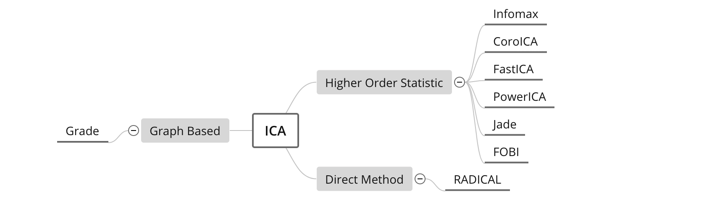
Independent Component Analysis A generic Algorithm description
Quick Summary of the Algorithm:
1. Subtract off the mean of the data in each dimension.
2. Whiten the data by calculating the eigenvectors of the co-variance of the data.
3. Identify final rotation matrix that optimizes statistical independence
Contribution of ICA algo: formulate a contrast function that measures how close the estimated sources are to statistical independence
Reach goal by minimizing or maximizing defined objective
ICA Algorithms – a subjective selective overview:
[Sejnowski TJ , 1995] ]
[Pfister 2019], ]
[Hyvärinen, 1999]
[Basiri, 2017 ]
[Miettinen, 2020]
[Sejnowski TJ , 1995]
[Cardoso 1993 ]
[Learned-Miller, 2003]
Notes:
Measure for non gaussianity: kurtossis measure for statistically independent Kullback Leibler
Central limit theorem: overlay

Slide 15
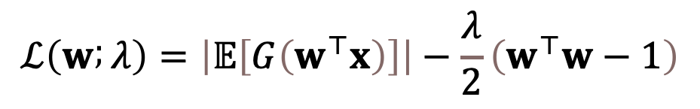
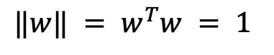
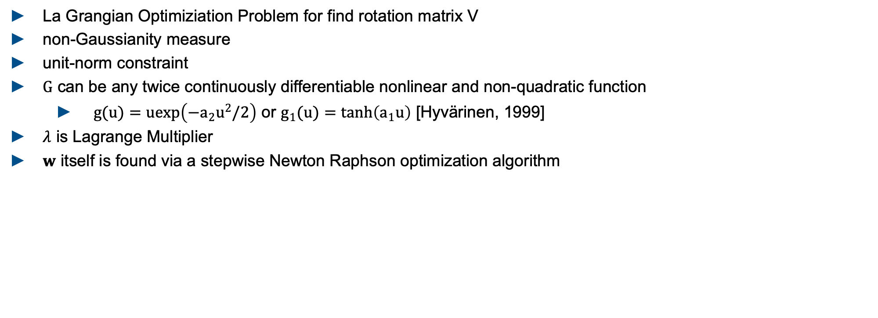
Independent Component Analysis Example Concept PowerICA [Basiri, 2017]
$$ℒ\left(w ; λ\right)=\left|𝔼\left[G\left(w^{⊤}x\right)\right]\right|−\frac{λ}{2}\left(w^{⊤}w−1\right)$$
local maxima
$$‖w‖ = w^{T}w = 1$$
La Grangian Optimiziation Problem for find rotation matrix V
non-Gaussianity measure
unit-norm constraint
$G$ can be any twice continuously differentiable nonlinear and non-quadratic function
$g(u)=uexp\left(−a_{2}u^{2}/2\right)$ or $g_{1}(u)=tanh\left(a_{1}u\right)$ [Hyvärinen, 1999]
$λ$ is Lagrange Multiplier
$w$ itself is found via a stepwise Newton Raphson optimization algorithm

Slide 16
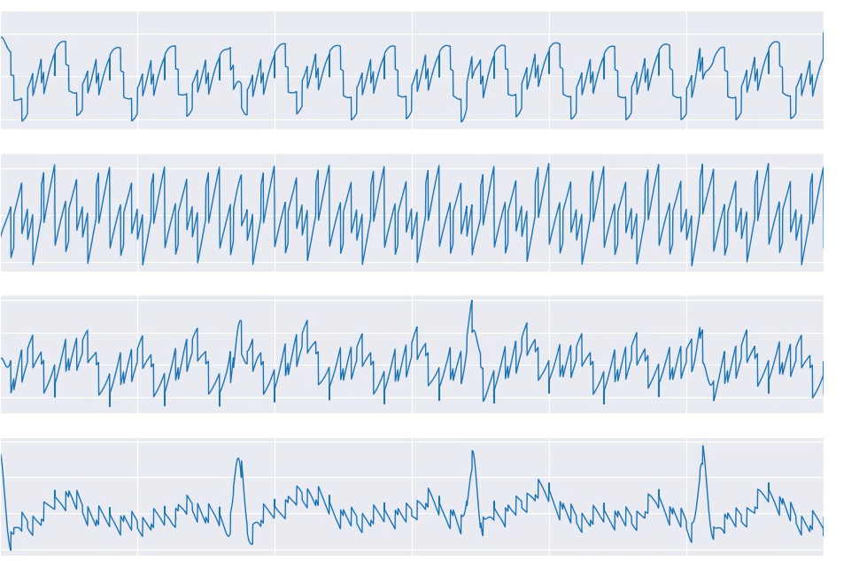
ICA Signal Reconstruction From Mixed Example Signals to Deconstructed Signals
Rectangle
Sin
Saw
ECG

Slide 17
Literature Chapter 1
[NY Times, 2020] https://www.nytimes.com/2018/01/18/arts/design/brain-neuroscience-santiago-ramon-y-cajal-grey-gallery.html
[BackyardBrains] https://backyardbrains.com/experiments/EEG#prettyPhoto
[iStock] https://medium.com/better-humans/how-to-have-more-meaningful-conversations-7b1f9120ff0d
[Hyvärinen, 1999] "Fast and robust fixed-point algorithm for independent component analysis" IEEE Trans. Neural Netw. vol. 10 no. 3 pp. 626-634 May 1999.
[Basiri, 2017] S., Ollila, E., & Koivunen, V. (2017). Alternative Derivation of FastICA with Novel Power Iteration Algorithm. IEEE Signal Processing Letters, 24(9), 1378-1382. [7994645]. https://doi.org/10.1109/LSP.2017.2732342
[Jutten, 2010] Handbook of Blind Source Separation: Independent Component Analysis and Applications
[Shlens, 2010]: A Tutorial on Independent Component Analysis
[Haykin, 2009], Neural Networks and Learning Machines
[Sejnowski TJ , 1995] Bell AJ, Sejnowski TJ (November 1995). "An information-maximization approach to blind separation and blind deconvolutio
[Learned-Miller, 2003] John W. Fisher III, "ICA Using Spacings Estimates of Entropy", Journal of Machine Learning Research 4 (2003) 1271-1295
[Pfister 2019], Robustifying Independent Component Analysis by Adjusting for Group-Wise Stationary Noise, Sebastian Weichwald, Peter Bühlmann, Bernhard Schölkopf; 20(147):1−50, 2019.
[Belouchrani 1997], K. Abed-Meraim, J.-F. Cardoso, and E. Moulines, “A Blind Source Separation Technique Using Second-Order Statistics,” IEEE Transactions on Signal Processing, vol. 45, no. 2, pp. 434–444, 1997.
[Cardoso 1993 ], A. Souloumiac, “Blind Beamforming for non Gaussian Signals,” IEEE Proceedings-F, vol. 140, pp. 362–370, 1993.

Slide 18
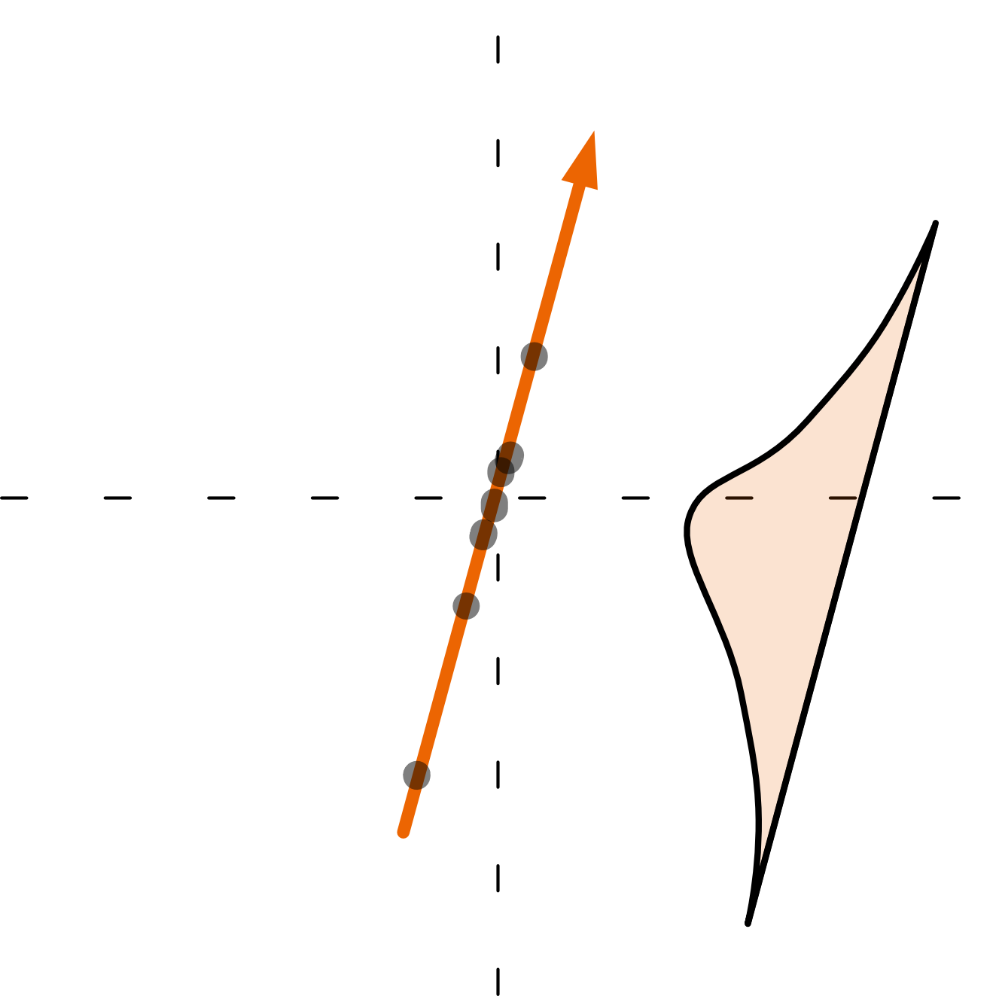
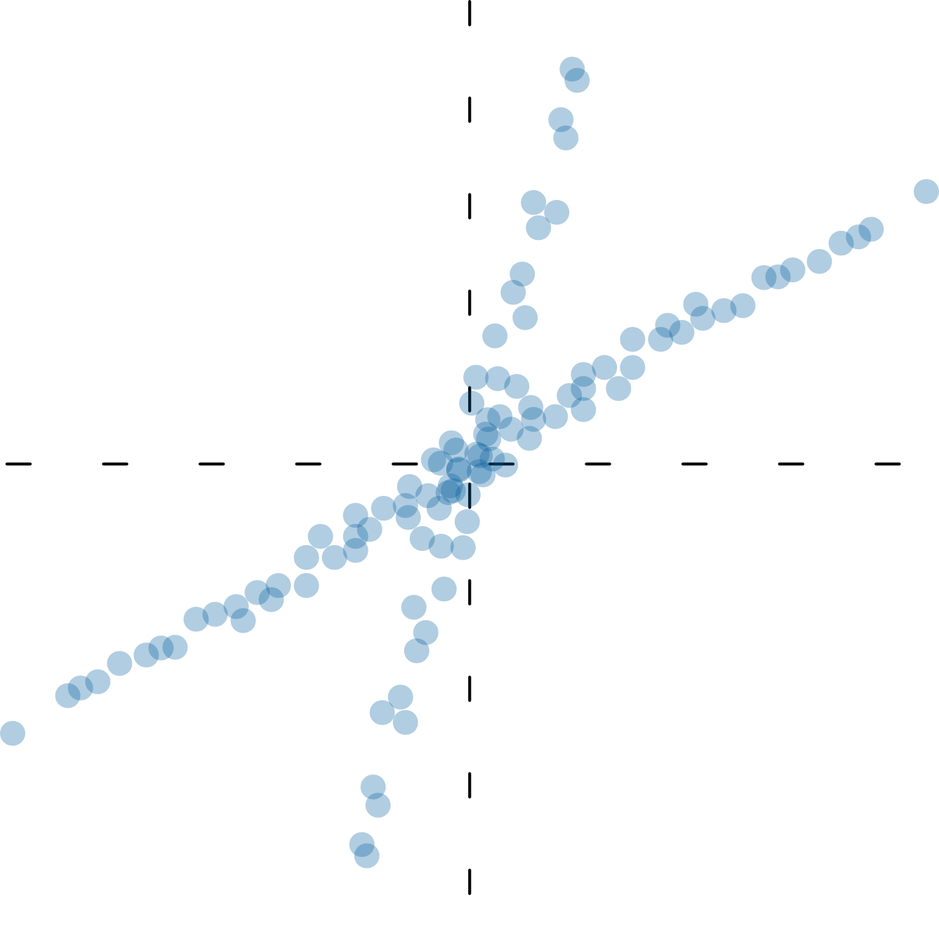
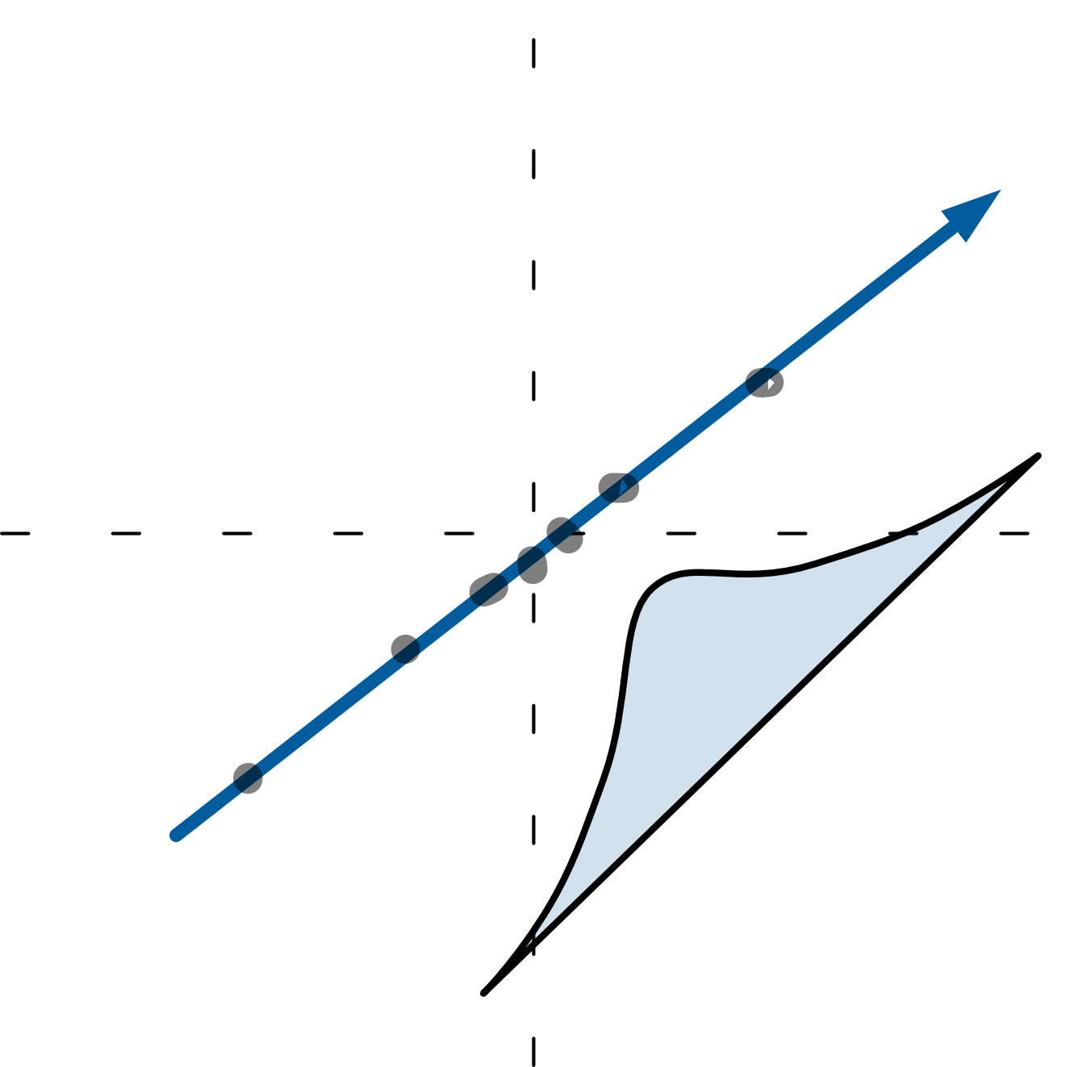

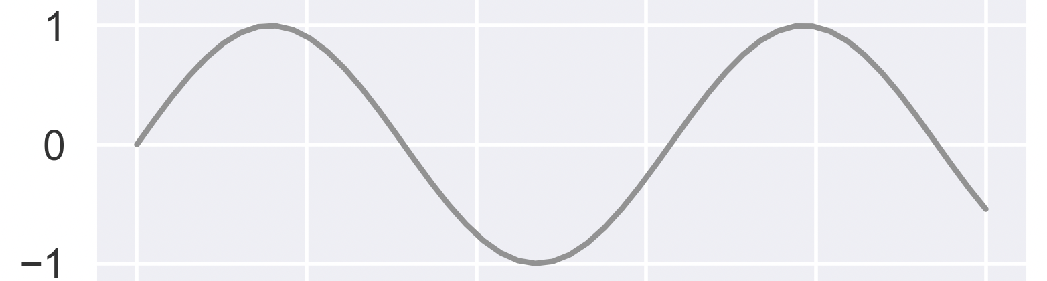
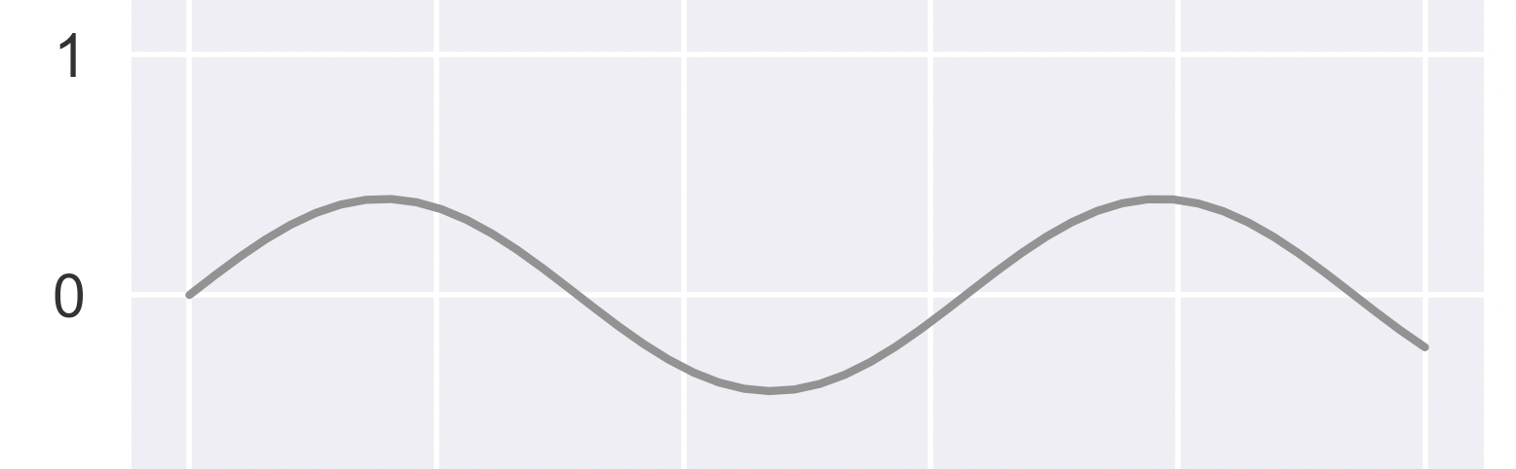
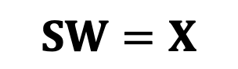
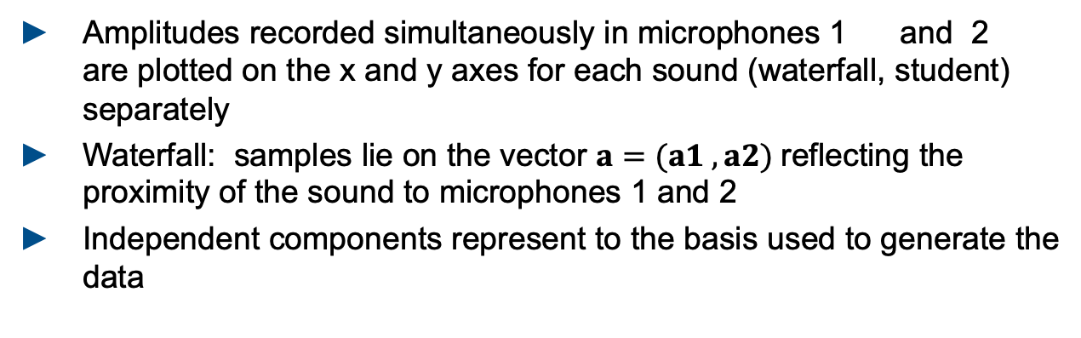

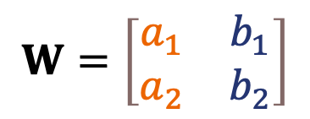
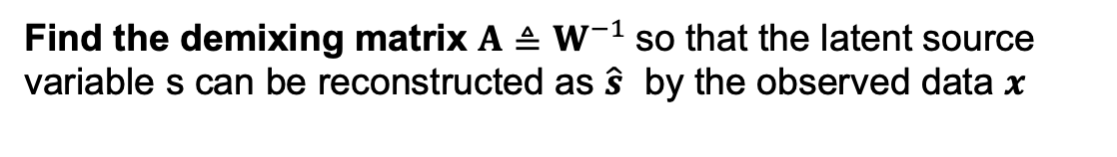

Back Up I: Alternative Interpretation of ICA
What is the goal of the algorithm?
$$SW=X$$
$$\hat{S}=XW^{−1}$$
Find the demixing matrix $A≜W^{−1}$so that the latent source variable s can be reconstructed as $\hat{s}$ by the observed data $x$
How can the the Independent Components be interpreted?
$$W=\left[\begin{matrix}a_{1} & b_{1} \\ a_{2} & b_{2}\end{matrix}\right]$$
$$+$$
$$=$$
Amplitudes recorded simultaneously in microphones 1 and 2 are plotted on the x and y axes for each sound (waterfall, student) separately
Waterfall: samples lie on the vector $a=(a1 , a2)$reflecting the proximity of the sound to microphones 1 and 2
Independent components represent to the basis used to generate the data
Notes:
The goal if ICA is to solve BSS problems which arise from a linear mixture
Find two unknowns A and s by only obersving theier matrix product x, underconstrained problem,
Amplitudes
Unsupervised learning problem

Slide 19





Back Up II: Notes on peculiarities of ICA
Original Signals
Permutation
Reconstructred signal Signals
Due to ambiguities of the method the extracting of the unobserved independent source signals is only accurate up to:
𝑑 × 𝑑 permutation matrix $P$, scaling matrix $D$ and sign-change matrix $L$
Permutation
Scaling
Sign Change
Notes:
P = (obtained by permuting the rows of 𝑑 × 𝑑 identity matrix),
D = (a diagonal matrix with positive diagonal elements)

Slide 20

Notes On ICA Assumptions
Components of the covariance matrix 􏰳{xxH} − 􏰳{x}􏰳{x}H are second order cumu
lants. The higher order cumulants of x can be considered as a measure of the gap t
o Gaussianity since they are zero when variable x is normal.

Slide 21

Notes On ICA Basic Math

